Slide 1

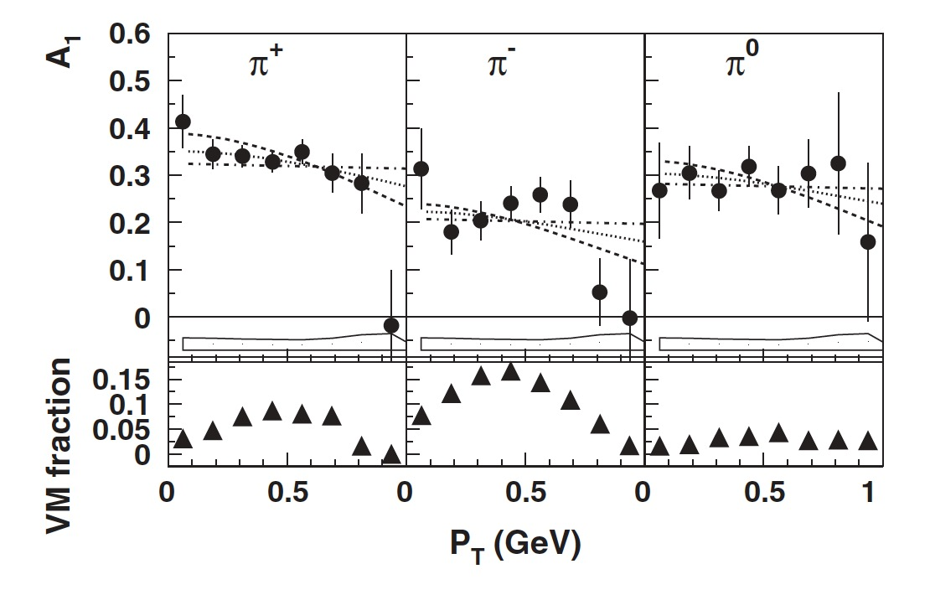


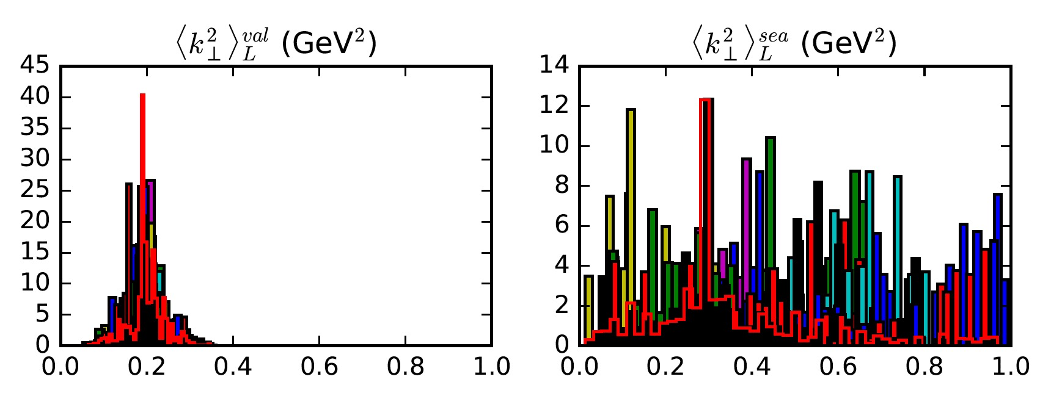
Spinning Protons and the Hidden Life of Their Constituents Longitudinally Polarized TMDs from JLab Data
M. Albright¹, S. Dolan², A. Duong², L. Gamberg², D. Pitonyak², A. Prokudin^{2,3}, Z. Scalyer², D. Xu²
¹ College of Engineering, Penn State University
² Division of Science, Penn State University Berks
³ Theory Center, Jefferson Lab, Newport News
introduction
We note that a recent paper [2] studied the SIDIS process and limits of TMD factorization. The authors proposed a criteria for identifying the current fragmentation region — the kinematical region where a factorization picture with fragmentation functions is appropriate for studies of transverse-momentum-dependent (TMD) functions - based on a rapidity selection filter of the data. In an extraction of the unpolarized widths, we applied a cut on the boost invariant difference of the target nucleon rapidity, and the produced hadron rapidity in the Breit frame, y_{p} - y_{h}. The value for we found was ~ 0.32 GeV².
Protons and neutrons (nucleons), which make up the nucleus of an atom, are not fundamental constituents of matter, but rather are themselves made up of particles called quarks. These quarks are “glued” together by the strong nuclear force, which is mediated by another particle called the gluon. Any particle containing quarks and gluons is called a hadron. Moreover, the quarks are not static inside of a nucleon – they have an intrinsic momentum even for a nucleon at rest. One of the ways to access this intrinsic motion is through a process called semi-inclusive deep-inelastic scattering (SIDIS). In this reaction, a high-energy electron scatters off of a quark inside of the nucleon. This quark forms a hadron in the final-state (e.g., a pion), which is detected along with the scattered electron (see Fig. 1).
Figure 2: JLab Hall B A_{LL} data as a function of P_{hT}. Plot is from Ref. [1]
The model
The production of charged pions in SIDIS at low transverse momentum can be described in terms of convolutions of TMDs for distribution and fragmentation:
The transverse motion of the quarks is approximated through parton model kinematics into the observed transverse momentum of the hadron. This enables us to gather information from SIDIS for exploration of TMDs. We will use the following simple parametrizations for TMD distribution and fragmentation functions:
where are the unpolarized and polarized parton distribution functions and the fragmentation function for a particular quark type , and are parameters that characterize the widths of TMD distributions. In our description of JLab data, we use our previously extracted parameters for the unpolarized widths
. We will then fit the polarized widths for the valence and sea quarks, respectively.
Using this model, A_{LL} can be written as
where , , and a is the quark flavor.
RESULTS
Figure 1: Schematic diagram of semi-inclusive deep-inelastic scattering (SIDIS): a high-energy electron knocks a quark out of the nucleon. The quark forms a pion in the final state, which is detected along with the scattered electron.
Figure 3: Fit results for JLab Hall B A_{LL} data. Plot of A_{LL} vs. P_{hT} .
The Purpose
The purpose of this project is to perform a phenomenological analysis of SIDIS data from Jefferson Lab (JLab) Hall B on a polarized target. This study gives us information on how the intrinsic motion of quarks inside nucleons, which is encoded in so-called transverse momentum dependent functions (TMDs), is affected by spin. Knowledge of these TMDs allows one to create a momentum space 3-D image of the polarized nucleon.
Figure 4: Parameter distribution after the nested sampling.
The results of our fit are shown in Figs. 3, 4. We see that the our model describes the data fairly well, with = 1.37. We also find that = 0.2 GeV², which is about 30% smaller than the unpolarized width. Therefore, the quarks are not as spread out inside a longitudinally polarized nucleon.
The DATA
(1)
The data used in this analysis is from JLab Hall B. The experiment scattered 5.7 GeV longitudinally polarized electrons on a longitudinally polarized proton target and detected pions in the final state. Measurements were made of the double-longitudinal spin asymmetry, A_{LL} , defined as the ratio of the polarized to the unpolarized SIDIS structure functions:
JLab Hall B collected data for 0.9 < Q² < 5.4 GeV², 0.12 < x_{B} < 0.48, P_{hT} < 1.2 GeV, and 0.4 < z_{h} < 0.7. Some of the data is shown in Fig. 2.
Conclusions and outlook
DATA SELECTION AND Analysis
We performed a phenomenological analysis of JLab Hall B data on the electroproduction of charged pions from a longitudinally polarized proton. We find that the polarized transverse momentum widths are about 30% smaller than the unpolarized widths. This suggests the intrinsic motion of quarks depends on the spin orientation of the nucleon.
We apply Eq. (1) to the data and use the standard minimization procedure, along with a nested sampling algorithm [3], to find
. The main objective of our analysis is to see if these polarized widths are different from the unpolarized ones. That is, we want to determine if the intrinsic motion of quarks changes when the nucleon has a longitudinal spin.
Acknowledgements
We would like to acknowledge partial support from NSF under Contract No. PHY-1623454, DOE under Contracts No. DE-FG02-07ER41460, by the U.S. Department of Energy, Office of Science, Office of Nuclear Physics, within the framework of the TMD Topical Collaboration.
[1] H. Avakian, et al., Phys. Rev. Lett. 105, 262002 (2010), [2] M. Boglione, et al., Phys. Lett. B766, 245-253 (2017),
[3] Skilling, John (2006). "Nested Sampling for General Bayesian Computation". Bayesian Analysis. 1 (4): 833–860

